Slide 1
STARWARES
Business
Presentation

Slide 2


LOGO DETAILS
STARWARES:
The logo represents cloud storage,data visualization,data intrepetation,organised way,machine learning,creativity and statistics.
The company provides best solution to the problems given to us in a organised way with creativity using statistics,machine learning and data are intrepreted,visualised and stored in cloud storage.
FARMLAND:
The logo represents 'There will be always sun and wind which guides us through the problems'.

Slide 3
Our Vision
Vision:
To maximum utilization of the available and emerging technologies to lever the evolution of modern agriculture
Mission:
To persistently persue through the challenge in serving customers with products of uncompromising quality.
Values:
Creative, flexible and innovative
Value for the environment and ecosystem
Quality, equality and ethics

Slide 4

MARKET RESEARCH / ANALYSIS
Based on our case study, we estimate the expected sale of vegetables to about 50 houses in the beginning month.
It will be increase month by month.
Establishing idea of approaching colleges and hostels.
Competitor analysis
Market analysis includes
PESTEL analysis,
SWOT analysis and
BEP analysis.,etc.

Slide 5
1
SOLUTION ARCHITECTURE:
FARMERS SECTION
BUYERS CORNER
LOGISTICS FIRM
PRODUCTS SELECTION PAGE
ACCOUNT REGISTRATION PAGE
ACCOUNT REGISTRATION PAGE
EXISTING CUSTOMER
NON_EXISTING CUSTOMER
PRODUCT SPECIFICATION PAGE
TRAVEL SPECIFICATION PAGE
ACCOUNT REGISTRATION
ORDER PAGE

Slide 6
1
SOFTWARE INSIGHTS:
PROGRAMMING LANGUAGES
SOFTWARE SERVICES
HTML5
CSS
JAASCRIPT
PHP
MySQL
XML
JAVA
NODE.JS
PYTHON
TENSORFLOW
NOTEBOOK
WATSON ASSISTANT
WATSON VISUAL RECOGNITION
WATSON DISCOVERY
IBM CLOUD FUCNTIONS
CLOUD FOUNDRY
IBM POWERAI
IBM API's
Web Tool
Android
Tool
Hardware API Interation Platform
SOLUTION METHODS
ARTIFICIAL INTELLIGENCE
MACHINE LEARNING
WEB DEVELOPMENT
AI & ML Implementation Tools

Slide 7
DATA FLOW :
Customer Order
Marketing Department
Production Department
Quality Department
Sales Department
Farmer Registration
Marketing Department
Purchase
Department
Logistics Registration
Marketing Department
Process
Department

Slide 8
1
SOFTWARE PRODUCTS:
SMART HELP DESK
CAP
It is a kind of guidebook or working manual that gives relevant information for the user when they ask for information
Citizens Assistant Portal has various functions that could help a citizen to survive in this pandemic
RECYCLE APP
FARMLAND
Building a mobile app that can classify trash into three categories: landfill, recycling, or compost
It is an E-Commerce website which will have different sections like Buyers,Sellers and logistics will be used online purchasing

Slide 9
1
RESEARCH & DEVELOPEMENT INTERMS OF USER INTERACTION:
Image processing,
To improve the buyers section like online market
Quality in and out check
Machine Learning along with visual recognition to
identify the ediblity of the products
Chatbot Integrations for user queries

Slide 10

MARKETING AND SALES PRESENTATION

Slide 11

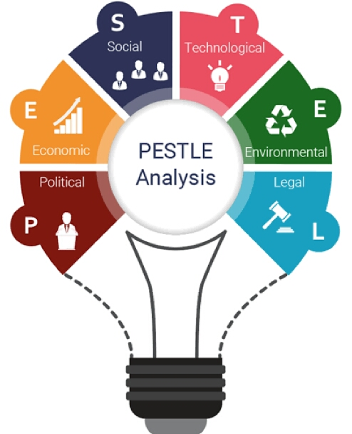
PESTEL ANALYSIS
PESTEL analysis can be best described as a framework that is mainly used by the marketers in analysis and monitoring of the macro environmental factors that are associated with a business.
The results obtained from the pestel analysis are often used in identification of threats and weakness in SWOT analysis of a company.
PESTEL is an acronym for Political, Economic, Social, Technological, Environmental and Legal condition.

Slide 12
PESTEL ANALYSIS
P
E
S
T
E
L
Political
Economic
Social
Technological
Environmental
Legal
Government policies
Increase in
consumerism
Rapid technological obsolescence
Climate and weather
Consumer rights and laws
Home economy situation
Tax policy
Government type and stability
Rising interest in environmental problems
Increase in online buying habits
Increase in efficiencies of IT resources
GDP growth
Advertising standards
Labour costs
Trade restrictions
Increase in rates of cybercrime
Health and safety laws
Environmental legislation

Slide 13
SWOT ANALYSIS
Strengths
W
Weaknesses
No intermediator
Promoting organic agriculture
Unnecessary price change
Under- estimating the competitors
Inexperienced in e-commerce and social media
Resource limitations
S
O
Threats
Opportunities
T
Quality maintenance
Goods distribution
Goods retrival
Online payment modes
Expansion in state level
Apps development

Slide 14
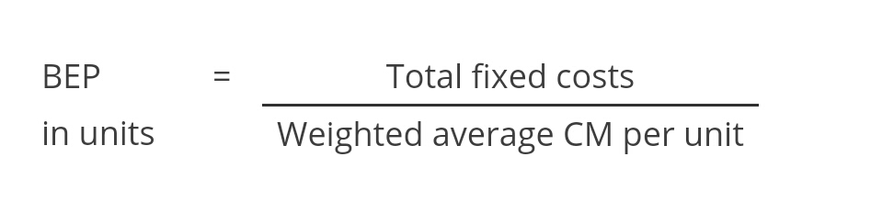
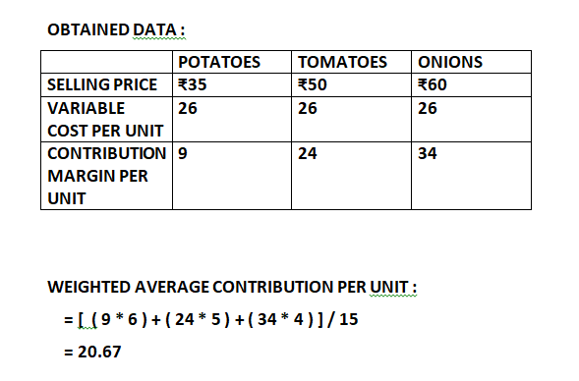
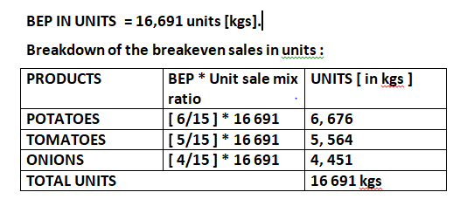
BREAK EVEN ANALYSIS
In economic & business , specifically cost accounting, the Break even point (BEP) is the point at which cost or expenses and revenues are equal: there is no net loss or gain, and one has “ broken even “.
The total fixed costs per month is ₹3,45,000.
The total variable costs per month is ₹19,500.
We found out the BEP [ in units ] for considering only three vegetables.
The average required sales mix per month is 6:5:4 ratio of Potato ,Tomato and Onions.
Based on our study we obtained the results as follow as:

Slide 15
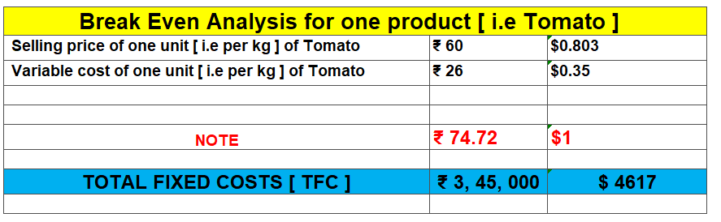
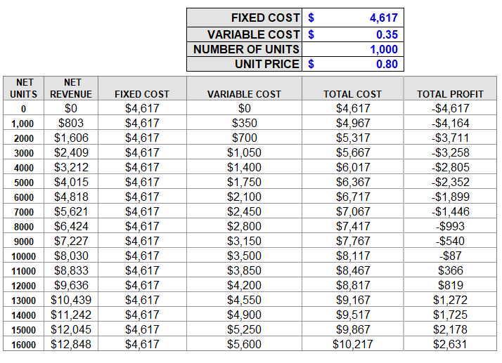
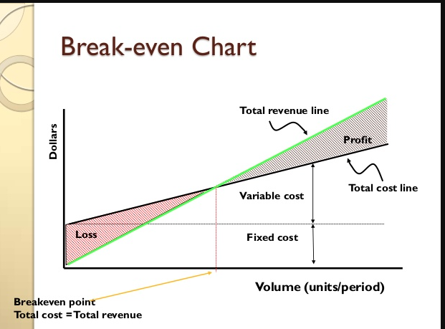
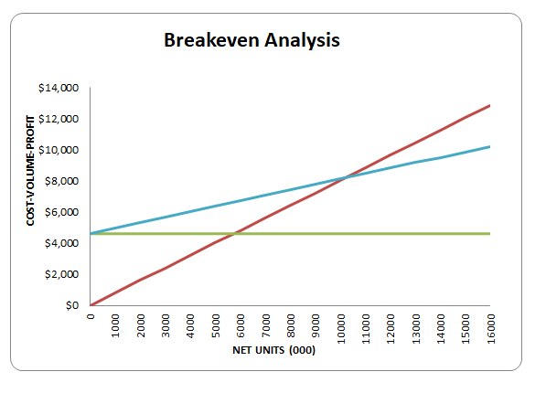
BEP GRAPH FOR ONE PRODUCT

Slide 16

MARKETING AND SALES
Marketing strategies
How to target customers
Advertising ideas
Estimation of cost for advertising
Exclusive points
Assured guarantee for best quality and delivery of products.
Customer feedback
Top 3 salient saleable features
Digital India
Emerging online shopping due to pandemic situation
Customer satisfaction [ in easy way of shopping at home & standards, delivery modes, payment modes.,etc ]

Slide 17
FUTURE TARGETS
State level distribution
Own logistics
Online visual sales
Conversion of retailers into farmers
Introducing door delivery for small goods

Slide 18
A brief description of process planning department

Slide 19
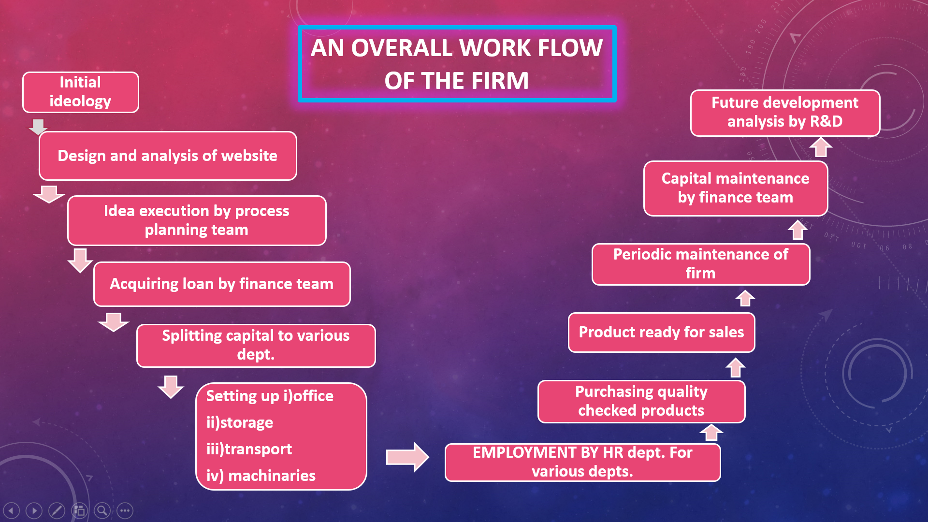

Slide 20
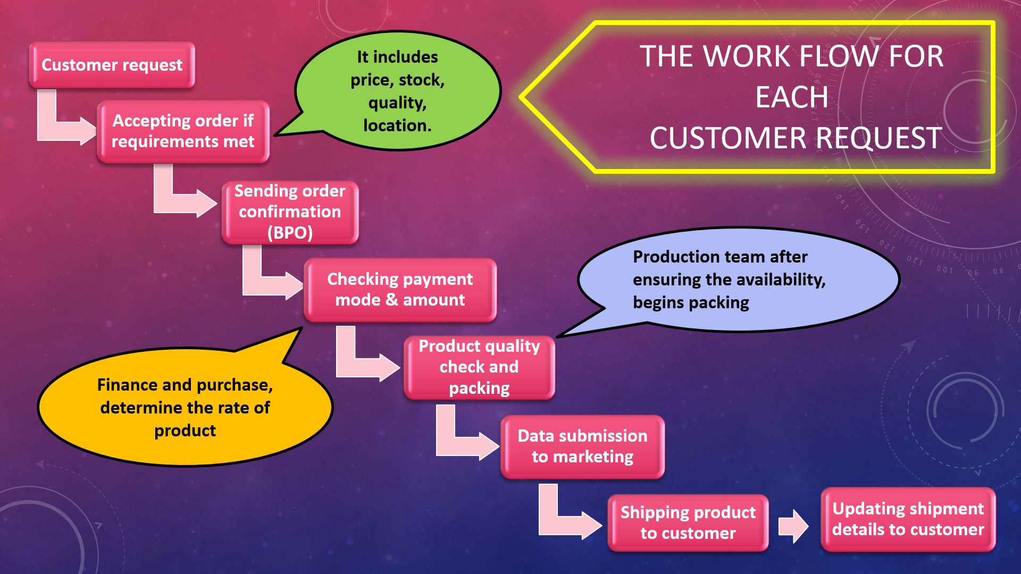

Slide 21
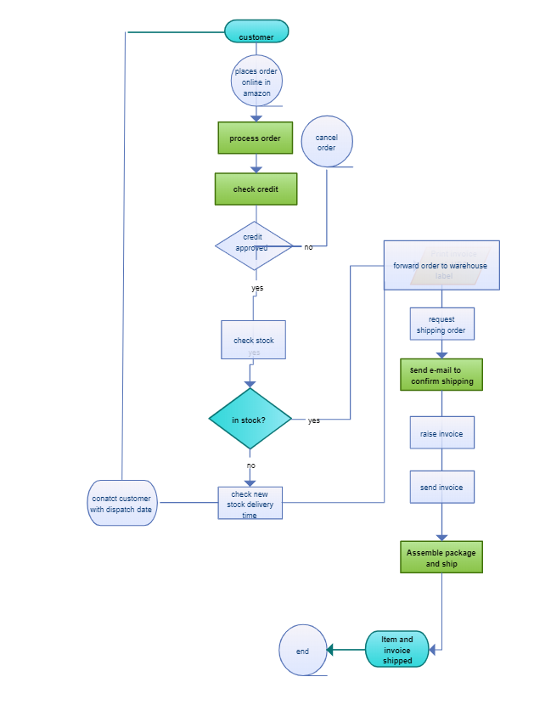
AMAZON’S
PROCESS
FLOW IDEA
FOR
REFERENCE
Amazon’s simple process flow of processing an order placed by their customer in their website.

Slide 22
CONTRACT SUPPLIER
CONTACT WITH BPO
UPDATING PRODUCT AND QUANTITY TO THE WEBSITE
STORAGE OF PRODUCT TILL SHIPPING
PURCHASE TEAM WORKING WITH PRODUCT RATE DETERMINA-TION
ACQUIREING PRODUCT FROM SUPPLIER
MAINTENA-NCE OF PRODUCT
WORK FLOW OF PRODUCT
FROM SUPPLIER
PERIODIC QUALITY CHECK IS DONE, AND ASSEMBLED IN INVENTORY
A PRIMARY QUALITY CHECK IS PERFORMED BEFORE PICKUP TO INVENTORY
FIRST IN, FIRST OUT METHODOLOGY IS OPTED FOR BETTER QUALITY

Slide 23
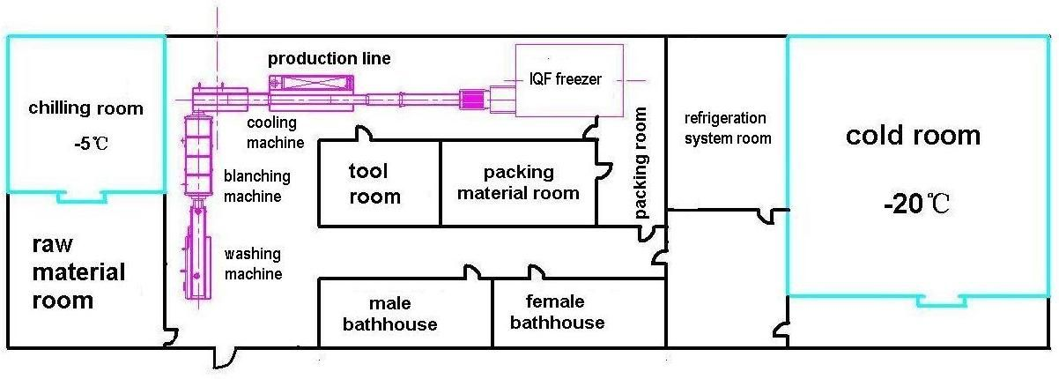
SAMPLE PLANT LAYOUT OF THE INVENTORY

Slide 24
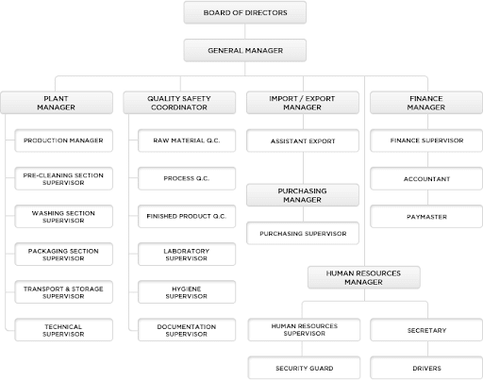
ORGANISATIONAL STRUCTURE OF THE INDUSTRY

Slide 25
PURCHASE DEPARTMENT

Slide 26

Reaching Producer
Reaching producers through online ads are quite difficult.
Mouth to mouth marketing will an effective way to reach our producers.
And also we can use referring schemes, producer referring another producer, so that he can take a cut in share(Multi Level Marketing).
News paper ads.

Slide 27

Negotiation
Offer greater price than government, private collection centre.
Giving offer, discounts to the buyers who is also a seller.
Constantly maintaining good relation with the producer, so that they becomes a potential seller in the future.
For example, purchase price of tomato per kg is Rs. 18 and selling price Rs. 26.

Slide 28
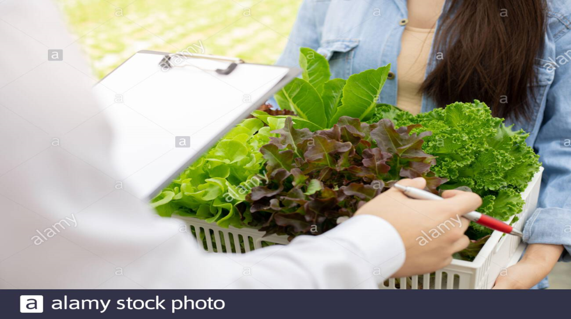
Quality Control
Our quality check team verify the quality of the vegetables while purchasing.
And then at the ware house the vegetables a separated as grade 1, grade 2, etc.. Depending on its quality.
Selling price of the product is determined by the quality of the product.
Producer
Intermediate
Quality check team
Buyer

Slide 29

Reaching Customers
Our potential customers are mobile, laptop, tab users.
So we shall use online ads platform to reach out our potential customers.
Online ads are little cheaper than TVs, paper ads.
To maintain the strong customer base we shall provide frequent offers and discount, without affecting our profit margin.
And also to attract the non android, ios users we shall provide them a toll free number, through which they can order

Slide 30
Concept and Quality Department

Slide 31
Roles and responsibilities
Quality control is a process intended to ensure that product quality or performed services adheres to a defined set of criteria or meets the requirements of the client . Through the quality control process ,the product quality will be maintained and defects will be maintained and refined.
Quality check points for inward and
outward
Quality policy for product as well as other department process
Setting up food standards
Quality report from seller and buyer using mobile app for first level check

Slide 32
Quality checks
1st LEVEL CHECK:
First level check is done by getting photo samples of vegetable from seller . From that physical quality is identified.
2nd LEVEL CHECK:
Second level check is done by getting vegetable sample from seller . This is followed by sampling and exact quality is identified.
3rd LEVEL CHECK:
Third level check is done before packing to ensure the quality once before shipping products.

Slide 33
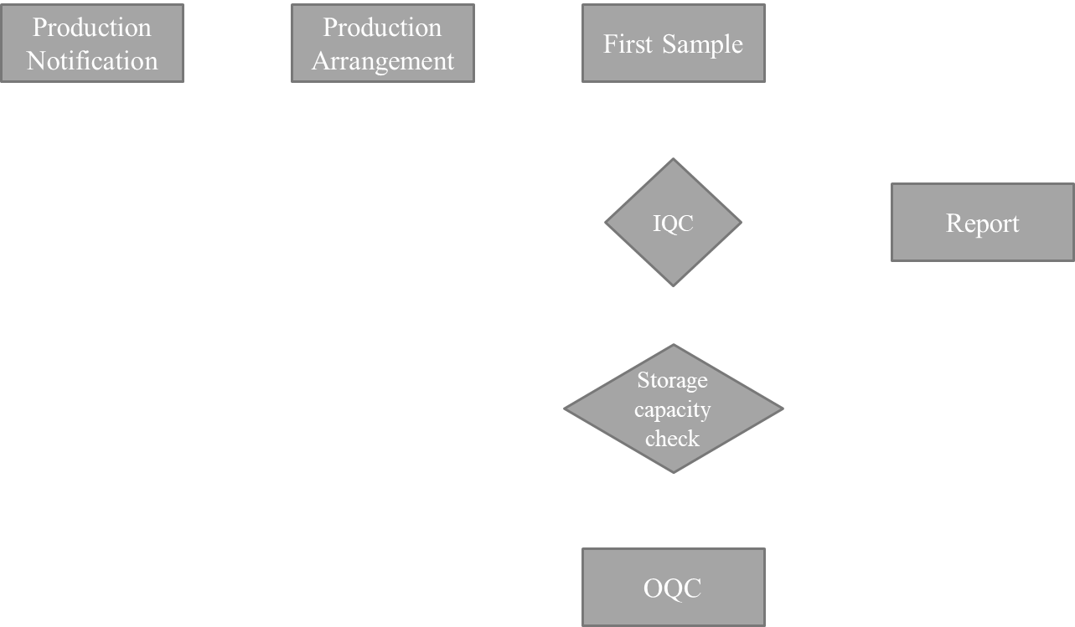
QUALITY CHECK PROCESS FLOW
IQC - Incoming Quality Check
OQC - Outgoing Quality Check
QA - Quality Assurance
Exception handling
Special Treatment
Purchase Department
Packing
QA

Slide 34
SETTING FOOD STANDARDS
Standardisation in the field of fruit and vegetable and their derived products, in particular , terminology ,sampling ,product specifications , requirements for packaging , storage ,transportation , methods of tests and analysis.

Slide 35

International food standards
ISO FOOD STANDARDS:
ISO 22000 sets out the requirement for a food safety management system and can be certified to it . It maps out what an organization needs to do to demonstrate its ability to control food safety hazards in order to ensure that food is safe.
ISO 7466:1986
Fruit and vegetable products – Determination of 5-hydroxymethylfurfural content.
ISO 7558:1988
Guide to the prepacking of fruits and vegetables.
ISO 7563:1998
Fresh fruits and vegetables.
For example:
Carrot:
ISO 2166:1981 – Guide to storage
Onions:
ISO 1673:1991 – Guide to storage

Slide 36
FSSAI FOOD STANDARDS
In India the Food Safety and Standards Authority of India (FSSAI) is the apex food regulator. It is empowered by and functions under the Ministry of Health and Family Welfare, Government of India. The FSSAI implements and enforces food regulations as prescribed in the Food Safety and Standards Act, 2006 (FSS Act).
Foods Imported into India have to follow the FSS Act, Rules & Regulations If the food articles are standardized, the importer only needs a FSSAI license to import them. The importer also needs to comply with FSSAI regulations for sale and distribution of the food products.
The importance of FSSAI License is that it ensures that is your food is verified chemically and hence is safe to consume.
FSSAI Registration ensures the security of food products and it is essentially a food safety certificate circulated by the authority of India.
Eligiblity:
All manufacturers, grocery shops, importers, exporters are eligible for issuing FSSAI License.

Slide 37
FSSAI REGISTERATION PROCESS
1.Study on FSSAI
2.Preparing the needed documents for registration
3.Apply for registration either offline or online
4.Frequent checking of application status
5.Inspection of FSSAI authorities
6.Getting FSSAI licence
7.Renewal of FSSAI licenceeither offline or online
8.If renewal is failure, we will apply for fresh FSSAI application

Slide 38
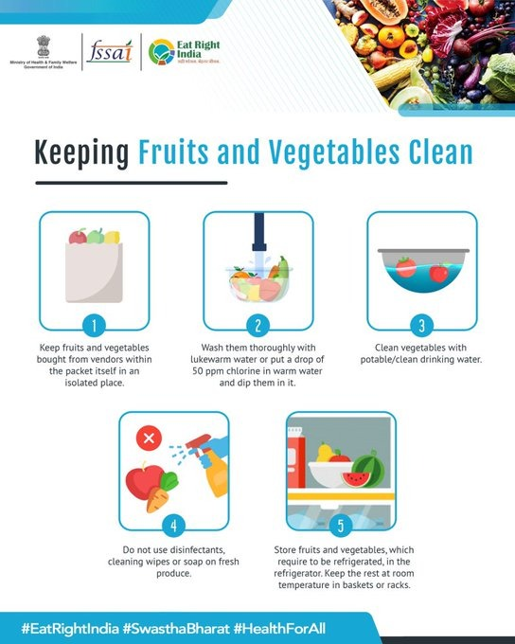
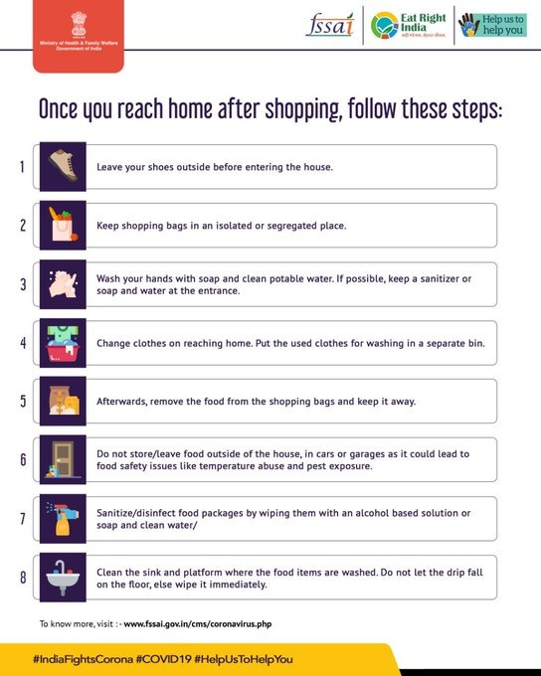
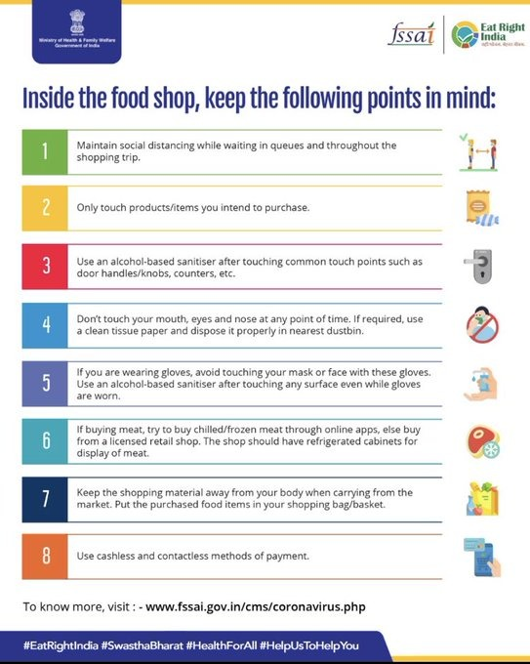
KEEPING FRUITS & vegetables clean during covid-19

Slide 39
PRODUCTION DEPARTMENT
AIM : To increase the productivity and to deliver the product in time.

Slide 40


Slide 41
STEPS TO INCREASE PRODUCTIVITY
Delivering goods just in time.
Fast communication between the departments.

Slide 42
FLOW FOR CUSTOMER REQUEST
Customer request
Accepting order and sending confirmation
Preparing the corresponding goods for delivery
Quality checking
Shipping out
Message received from customer as goods received

Slide 43
INVENTORY
INLET
STORAGE
OUTLET

Slide 44
FLOW FOR RECEIVING FROM FARMER/ SELLER
Order received
Confirmation of order
Place will be arranged for new goods in the warehouse
Goods will be weighed and arranged
Message to the admin as goods stored.
Updated goods in the website.

Slide 45
INVENTORY OR WAREHOUSE
INLET – Once we procure goods from the seller, they are assessed qualitatively and quantitatively, they are labelled and put in the allotted spaces.
STORAGE – The goods are stored in a control environment and are checked on a regular basis and are delivered on a first in first out basis.
OUTLET – Once we obtain the order, the respective goods are weighed and packed and are prepared for the transport.

Slide 46
ROBOTS USED IN WAREHOUSE
Every product will be attached with a QR code along with tracking sensor.
An unit of robots will be used to track the products and deliver it from the inlet to storage and from storage to outlet accordingly.
After a product is taken, the products there are rearranged on the basis of arrival such that there will always be a gap at later end for the arrival of new goods.

Slide 47
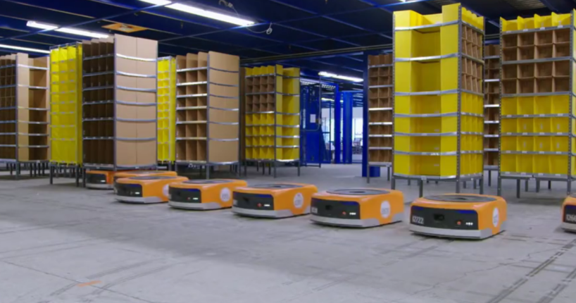
ROBOTS IN WAREHOUSE
In warehouse, robots will navigate using sensor tracking.
Each box of item will be tagged along with a tracker with which the robots will track them.
The estimated cost of each unit will be around 70 lakhs per warehouse.

Slide 48

QR CODE DETAILS
The following will be the details included in the QR code in the warehouse.
Name of the farmer/seller.
Date of procuring.
Item description.
Quantity or weight.
Serial number.

Slide 49

business process outsourcing ( bpo )

Slide 50
BPO
CUSTOMER SERVICE – Customers will dial our toll free number and after few steps, it will reach our customer care, in which their queries will be answered accordingly.
TRANSACTIONS MANAGING- The BPO clerks will always monitor the transactions and whenever the problems arise, they try to solve it.
DATA ENTRY – At the end of every day, the day’s business will be documented and will be used for future purposes like survey, developing our company, etc.,

Slide 51
Finance department

Slide 52
Total investment
Month | Variable \ Fixed cost of the month | Farmer’s share | Initial investment \ last month’s investment | Total
1 | 810000 | 6000000 | 43232000 | 50042000
2 | 810000 | 6000000 | 50042000 | 56852000
3 | 810000 | 6000000 | 56852000 | 63662000
4 | 810000 | 6000000 | 63662000 | 70472000
5 | 810000 | 6000000 | 70472000 | 77282000
6 | 810000 | 6000000 | 77282000 | 84092000
7 | 810000 | 6000000 | 84092000 | 90902000
Initial Investment =720000 + 72000 + 40000+ 2400000 +40000000 = 4,32,32,000
Fixed cost = 15000 +50000 +5000 + 23 X 15000 +100000 +20 X 8000 + 5 X 12000 = 7,35,000 per month
Variable cost = 75,000 per month
Total investment at each month

Slide 53
Expected sale
Total no of delivery places : 100
Vegetables delivered in a : 50 kg per day and 1500 kg per
day and month in 1 place month
Vegetables delivered in a : 5000 kg per day and 1500000
day and month in 100 places kg per month.
Expected sale of product : 15,00,000 kg per month
in a month (1500 tonnes)

Slide 54
Expected income
Average price for the 1 kg : ₹60
Primary vegetables
Turn over for a day : 3,00,000
Turn over in a month : 90,00,000
Expected annual Turn : 10,80,00,000
over
Amount shared to farmer : 2,00,000 per day and
in a day and month 60,00,000 per month
Actual income per day : 1,00,000 per day and
and per month 30,00,000 per month

Slide 55
Break even analysis
Month | Total investment growth in each month | Total turnover per month | Amount remaining in total investment
1 | 50042000 | 9000000 | 41042000
2 | 59852000 | 18000000 | 38852000
3 | 69662000 | 27000000 | 36662000
4 | 79472000 | 36000000 | 34472000
5 | 89282000 | 45000000 | 32282000
6 | 99092000 | 54000000 | 30092000
7 | 108902000 | 63000000 | 27902000
8 | 118712000 | 72000000 | 25712000
9 | 128522000 | 81000000 | 23522000
10 | 138332000 | 90000000 | 21332000
18 | 162000000 | 165812000 | 3812000
19 | 171000000 | 172622000 | 1622000
20 | 180000000 | 179432000 | -568000
21 | 189000000 | 186242000 | -2758000

Slide 56
In 1 places | Per day | Per month
Expected sale | 50 kg | 1500
Expected turnover(per kg 60) | ₹3000 | ₹90000
In 100 places | Per day | Per month
Expected sale | 5000 kg | 15,00,000 kg
Expected turnover(per kg 60) | ₹3,00,000 | ₹3,00,000
Actual income | ₹:1,00,000 | ₹30,00,000

Slide 57
SSI AND MSME
The registration is possible only through the director of industries of the concerned state.
Two certificates will be given by the authorities such as
Provisional certificate (valid for first five years)
Permanent registration certificate
The registration is done only through online and is provided by the respective state government
(for Tamil Nadu : https://dcmsme.gov.in/howtosetup/grgxx01x.htm )

Slide 58
GST Registration
GST registration can be easily done on the online GST portal. Business owners can fill a form on the GST portal and submit the necessary documents for registration.
It is mandatory for certain businesses to complete the GST registration process.
It is a criminal offense to carry out operations without registering for GST and heavy penalties are levied for non-registration

Slide 59
ADMINISTRATION DEPARTMENT

Slide 60
MANAGEMENT OF EMPLOYEES
The details of all the employees are much needed which is important for management and safety purposes
The details are stored in database for management purposes mainly in cloud.
The cloud storage has maximum capacity and retrieval of data also is easy.
The details are also used for monitoring enter and exit of employees and helpful in managing the departments.

Slide 61
STARTUP INDIA REGISTRATION
steps for registration:
Incorporate your business
Register with startup india
Documents needed,
A letter of recommendation/support
Incorporation/registration certificate
Description of your business in brief

Slide 62
4. Answer whether we would like to avail tax benefits.
5. self-certify the certain conditions like turnover rate , innovation etc.,
6.Immediately get recognition number
7.Patents,Trademarks and Design registration
8.Funding sources

Slide 63
FACILITIES
1)CANTEEN FACILITY
For the employees,the canteen facility will be provided.They can eat lunch in canteen and beverages in breaktime.
2)TRANSPORTATION FACILITY
They are provided with transportation from their nearby stops, both pickup and drop.
3)DAYCARE CENTER
For workers with their children less than the age of five,day care center facility is provided.

Slide 64
4)SAFETY
The safety instruments are installed in required position in case of any accidents.
5)WI-FI FACILITY
The employees can use the company WiFi in the company perimeter.
6)TRAINING FOR NEWCOMERS
The training for newcomers in their respective position will be given.

Slide 65
HR POLICIES
1)MEDICAL POLICY
The medical insurance policy will be given for employees who worked more than 3 years.They can claim in case of accident or acute illness.
2)EMPLOYEE PROVIDENT FUND
Out of employer's contribution, 8.33% will be diverted to Employees' Pension Scheme.The balance will be retained in the EPF scheme. On retirement, the employee will get his full share plus the balance of Employer's share retained to his credit in EPF account.

Slide 66
3)EMPLOYEE STATE INSURANCES
By Employees' State Insurance Act, 1948 against the impact of incidences of sickness, maternity, disablement and death due to employment injury,we will provide medical care to insured persons and their families.
4)BONUS AND REWARDS
The bonus will be provided according to the company' s growth over a period of time.The rewards will be given for employees who excelled in their respective positions.

Slide 67
THANK YOU!

